Slide 1
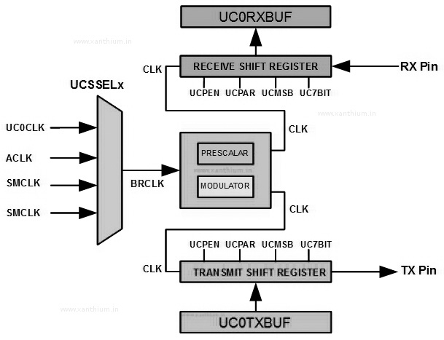

Slide 2
UCPEN | PARITY ENABLE : Used for enabling or disabling parity bit
UCPAR | PARITY SELECT : Used for selecting EVEN or ODD parity bit
UCMSB | MSB First Select : Controls the direction of receive and transmit register(if it is 0: LSB first)
UC7BIT | Selects the character length 7/8 bit(if it is 0 : 8 bit )
UCSPB | Number of stop bits (if it is 0 : 1 stop bit)
UCMODEx | USCI Mode: 2 bits used to select the asynchronous mode when UCSYNC = 0
UCSYNC | Synchronous mode enable : if it is 0 asynchronous(UART Mode), if it is 1 synchronous mode(SPI)

Slide 3
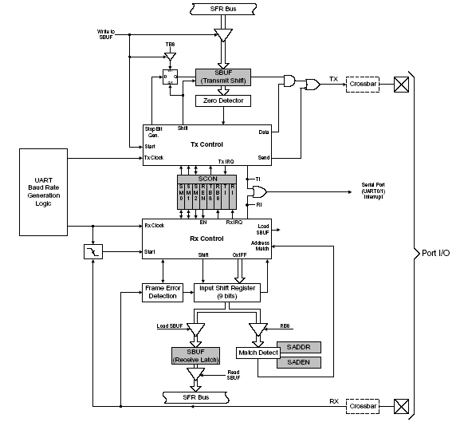
UART Block Diagram
Notes:
This diagram shows the various functional blocks of the UART. UART0 and UART1 are identical in their operation. There are two SFRs - SBUFx and SCONx – used to control and manage the serial communication.

Slide 4
Operation Modes
The UARTs have four modes of operation, selectable by configuring the SM0x-SM1x bits in SCONx register
Three modes enable asynchronous communications (modes 1 to 3) while the fourth mode (Mode 0) operates as a simple shift register (synchronous)
  8-bit shift register (mode 0)
    Used for port expansion using an external latch
  8-bit UART with variable baud rate (mode 1)
    Most commonly used mode of operation
  9-bit UART with fixed baud rate (mode 2)
    No timer required
    Choose between SYSCLK/32 or SYSCLK/64 for clock
  9-bit UART with variable baud rate (mode 3)
    Used if 9-bit data transmission is required
Notes:
SM0x-SM1x bits in SCONx register used to configure the mode of operation. In this lecture we will discuss only the 8-Bit UART with Variable Baud Rate (Mode 1).

Slide 5
SCONx (Serial Port control Register)
Bit | Symbol | Description
7-6 | SM0x-SM1x | Serial Port Operation Mode 00: Mode 0: Shift Register Mode 01: Mode 1: 8 Bit UART, Variable Baud Rate 10: Mode 2: 9 Bit UART, Fixed Baud Rate 11: Mode 3: 9 Bit UART, Variable Baud Rate
5 | SM2x | Multiprocessor Communication Enable The function of this bit depends on the Serial Port Operation Mode. Mode 0: No effect. Mode 1: Checks for valid stop bit. 0: Logic level of stop bit is ignored. 1: RIx will only be activated if stop bit is 1 Mode 2 & 3: Multiprocessor Communications Enable. 0: Logic level of 9th bit is ignored. 1: RIx is set and an interrupt is generated only when the 9th bit is 1 and the received address matches the UARTx address or broadcast address.
4 | RENx | Receive Enable 0: UARTx reception disabled 1: UARTx reception enabled

Slide 6
Bit | Symbol | Description
3 | TB8x | 9th Transmission Bit The logic level of this bit will be assigned to the 9th transmission bit in Modes 2 & 3. It is not used in Modes 0 & 1. Set or cleared by software as required.
2 | RB8x | 9th Receive Bit This bit is assigned the logic level of the 9th bit received in Modes 2 & 3. In Mode 1, if SM2x is 0, RB8x is assigned the logic level of the received stop bit. RB8 is not used in Mode 0.
1 | TIx | Transmit Interrupt Flag Set by hardware when a byte of data has been transmitted by UARTx (after the 8th bit in Mode 0, or at the beginning of the stop bits in other modes). When the UARTx interrupt is enabled, setting this bit causes the CPU to vector to the UARTx ISR. This bit must be cleared manually by software.
0 | RIx | Receive Interrupt Flag Set by hardware when a byte of data has been received by UARTx (as selected by the SM2x bit). When the UARTx interrupt is enabled, setting this bit causes the CPU to vector to the UARTx ISR. This bit must be cleared manually by software.
Notes:
The SCONx register is used to select the serial port operation mode and enable/disable UART reception. The mode of operation is configured by programming the SM0x-SM1x bits. For Mode 1 operation, set these bits to 01. TIx and RIx are the Transmit Interrupt Flag and Receive Interrupt Flag respectively.

Slide 7
PCON—Power Control Register
Bit | Symbol | Description
7 | SMOD0 | UART0 Baud Rate Doubler Enable 0: UART0 baud rate divide-by-two enabled. 1: UART0 baud rate divide-by-two disabled.
6 | SSTAT0 | UART0 Enhanced Status Mode Select
5 | Reserved | Read is undefined. Must write 0.
4 | SMOD1 | UART1 Baud Rate Doubler Enable 0: UART1 baud rate divide-by-two enabled. 1: UART1 baud rate divide-by-two disabled.
Notes:
The baud rate doubler enable (SMODx) bit is in PCON register.

Slide 8
3 | SSTAT1 | UART1 Enhanced Status Mode Select
2 | Reserved | Read is undefined. Must write 0.
1 | STOP | STOP Mode Select This bit will always read ‘0’. Writing a ‘1’ will place the microcontroller into STOP mode. (Turns off oscillator).
0 | IDLE | IDLE Mode Select This bit will always read ‘0’. Writing a ‘1’ will place the microcontroller into IDLE mode. (Shuts off clock to CPU, but clock to Timers, Interrupts, and all peripherals remain active).

Slide 9
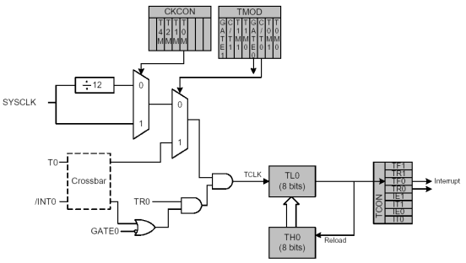
Using Timer 1 to Generate Baud Rate
Timer 1 in mode 2 (8-bit auto-reload mode) can be used to generate the baud rate for UART0 and UART1
Block diagram of Timer 0 in Mode 2 (8-bit Auto-reload mode)
Timer 1 is identical to Timer 0
Notes:
Timer 1 can be used to generate the baudrate for UART0 and UART1 in Mode 2 (8-bit Auto-reload mode).

Slide 10
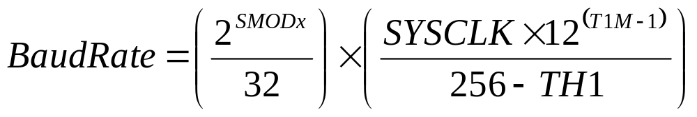
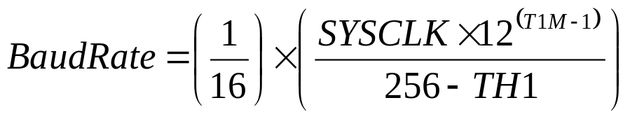
Baud Rate Calculations—Timer 1
The Baud Rate and Timer 1 reload value (for TH1 register) are related by the following equation:
If SMODx=1 (UART Baud Rate divide-by-two disabled)
Notes:
This slide shows the equation used to calculate the reload value of TH1 register when Timer 1 is used to generate the baud rate. The baud rate is dependent on the value of SMODx (Baudrate doubler) bit and T1M (SYSCLK divide-by-two enable/disable) bit.

Slide 11
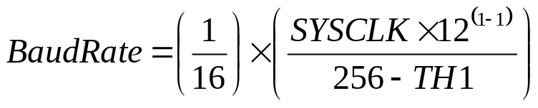
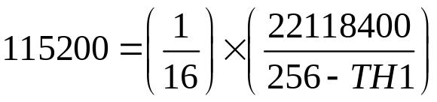
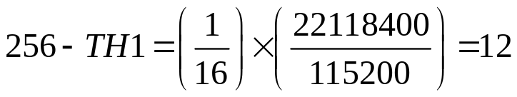


Baud Rate Calculations—Timer 1
If T1M=1 (timer 1 uses the system clock, NOT divided by 12):
If SYSCLK=22.1184 MHz and Baud Rate=115200, then:

Slide 12
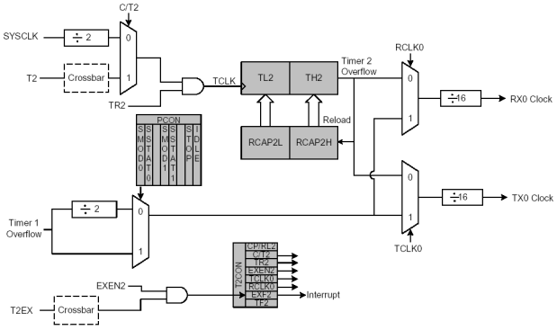
Using Timer 2 to Generate Baud Rate
If timer 2 (or timer 4) is used to generate the baud rate, it must be configured for mode 2 operation (auto-reload mode)
Notes:
To generate the baudrate using Timer 2 (or Timer 4), it must be configured for Mode 2 operation (Auto-Reload Mode).

Slide 13
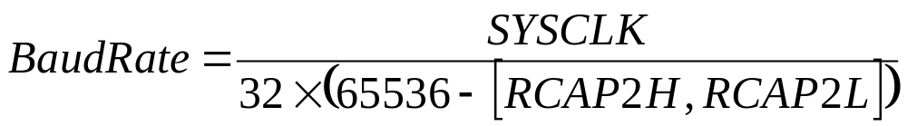
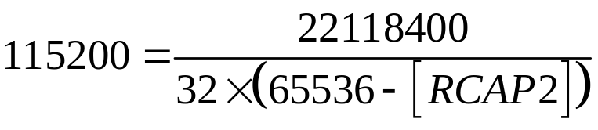
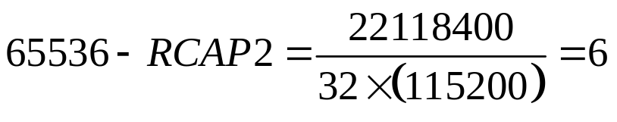

Baud Rate Calculations—Timer 2
The baud rate and timer 2 reload value (for RCAP2 register) are related by the following equation:
If SYSCLK=22.1184 MHz and BaudRate=115200, then:
Notes:
The baud rate is dependent on SYSCLK and RCAP2 (reload value in capture register).

Slide 14
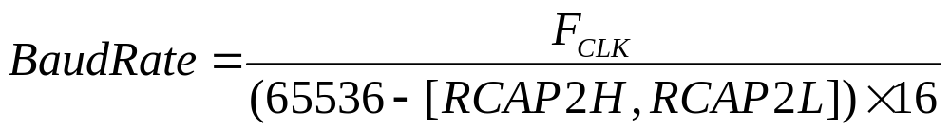
Baud Rate Calculations—Timer 2
If a different time base (other than SYSCLK) is required, setting the C/T2 (CAPTURE REGISTER) bit (in T2 CON register) to 1 will allow the time base to be derived from the external input pin T2
In this case, the baud rate for the UART is calculated as:
F_{CLK} is the frequency of the signal supplied to timer 2 and [RCAP2H, RCAP2L] is the 16-bit value held in the capture registers
Notes:
A different time base (other than SYSCLK) may be derived from the external input pin T2 to generate the baud rate.

Slide 15
UARTx Interrupt Flags—Receiving Data
The receive and transmit flags (RIx and TIx) in SCONx play an important role in serial communications
Both the bits are set by hardware but must be cleared by software
RIx is set at the end of character reception and indicates “receive buffer full”
This condition is tested in software (polled) or programmed to cause an interrupt
If the application wishes to input (i.e. read) a character from the device connected to the serial port (e.g. COM1 port of PC), it must wait until RIx is set, then clear RIx and read the character from SBUFx
Note: x = 0 or 1 for UART0 or UART1
Notes:
The Receive Interrupt and Transmit Interrupt flags (RIx and TIx) in SCONx are both set by hardware but must be cleared by software.
RIx is set at the end of character reception and indicates “receive buffer full”. This condition is tested in software (polled) or programmed to cause an interrupt.
If the application wishes to input (i.e. read) a character from the device connected to the serial port, it must wait until RIx is set (i.e. the receive buffer is full), then clear RIx flag and read the character from SBUFx.

Slide 16
UARTx Interrupt Flags—Sending Data
TIx is set at the end of character transmission and indicates “transmit buffer empty”
If the application wishes to send a character to the device connected to the serial port, it must first check that the serial port is ready
If a previous character was sent, we must wait until transmission is finished before sending the next character
Notes:
The TIx flag is set at the end of character transmission and indicates “transmit buffer empty”. If the application wishes to send a character to the device connected to the serial port, it must first check that the serial port is ready. If a previous character was sent, we must wait until transmission is finished before sending the next character.

Slide 17
Serial Peripheral Interface (SPI) :
Serial Peripheral Interface (SPI) is an interface bus commonly used to send data between microcontrollers and small peripherals such as shift registers, sensors and SD cards. It uses separate clock and data lines along with select line.
SPI is a hardware / firmware communications protocol developed by Motorola.
It is sometimes called as “four wire” serial bus. The Serial Peripheral Interface is a simple 4-wire serial communications interface. It operates at full duplex.

Slide 18
Data and Control lines of the SPI are:
Master Out Slave In (MOSI) – MOSI signal is generated by Master, received by the slave.
Master in slave out (MISO) – slaves generate MISO signals and received is the master.
Serial clock (SCLK or SCK) – SCLK signal is generated by the master to synchronize data transfers between the master and slave.
Slave select (SS) – It is an active low signal to select particular slave if two or more slaves are available.

Slide 19
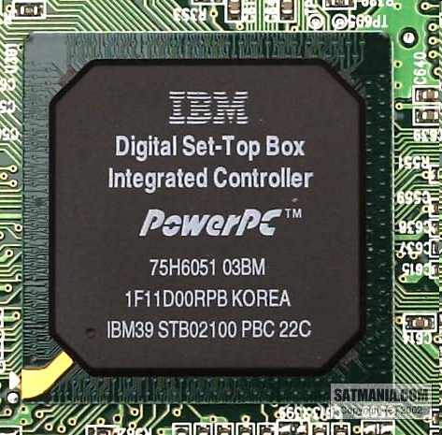
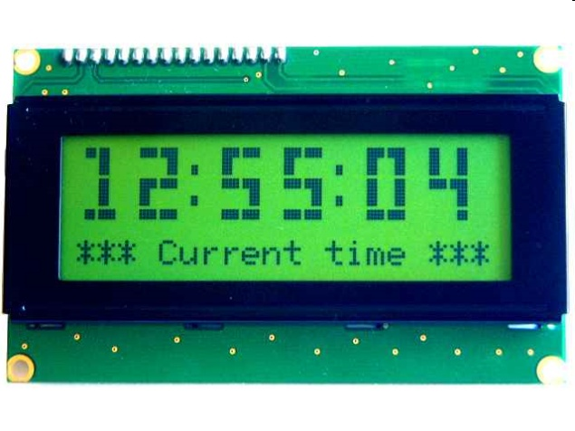
Serial bus protocol
SPI refers to serial peripheral interface. It is a synchronous serial communication interface specification used for short distance communication.
Fast, easy to use, and simple
Very widely used
Not “standardized”

Slide 20
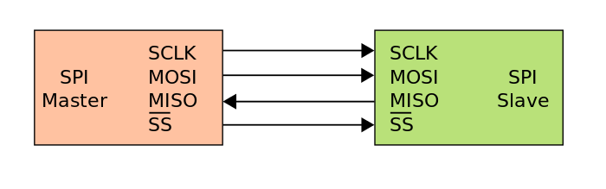
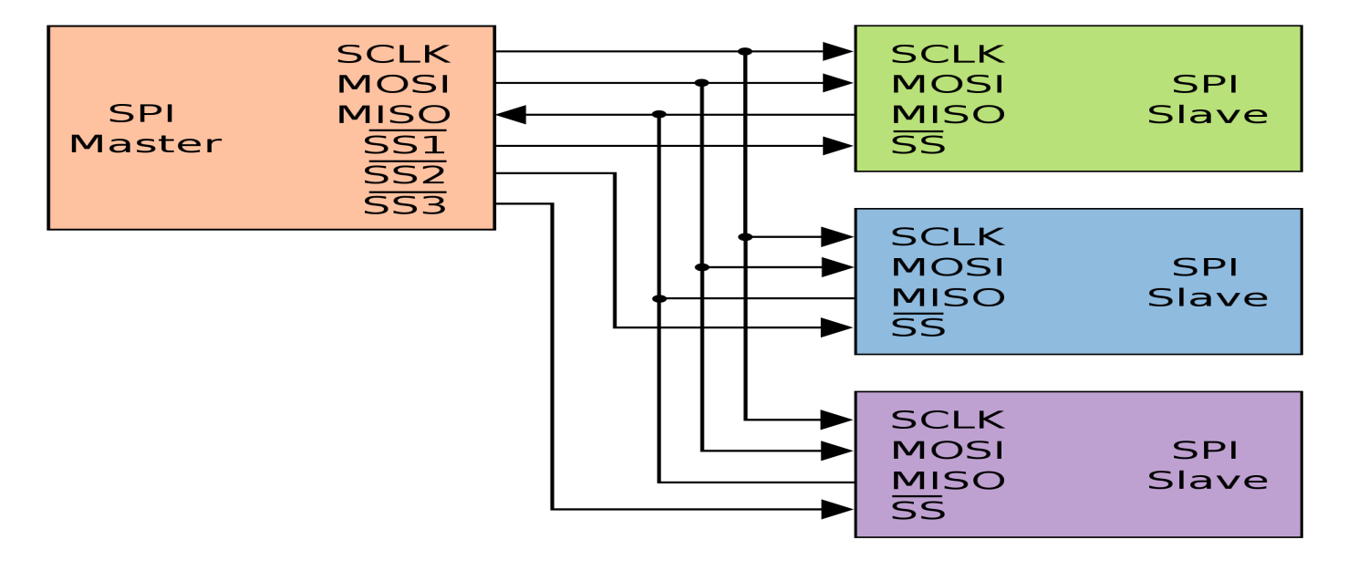
SPI Master connected to a single slave
SPI master connected to multiple slaves

Slide 21
A clock signal named SCLK, sent from the bus master to all slaves all the SPI signals are synchronous to this clock signal.
A slave select signal for each slave, ss used to select the slave the master communicates with.
A data line from the master to slaves, named MOSI (Master out - Slave In).
A data line from the slaves to master, named MISO (Master in - Slave out).
SPI is a single master communication protocol.

Slide 22
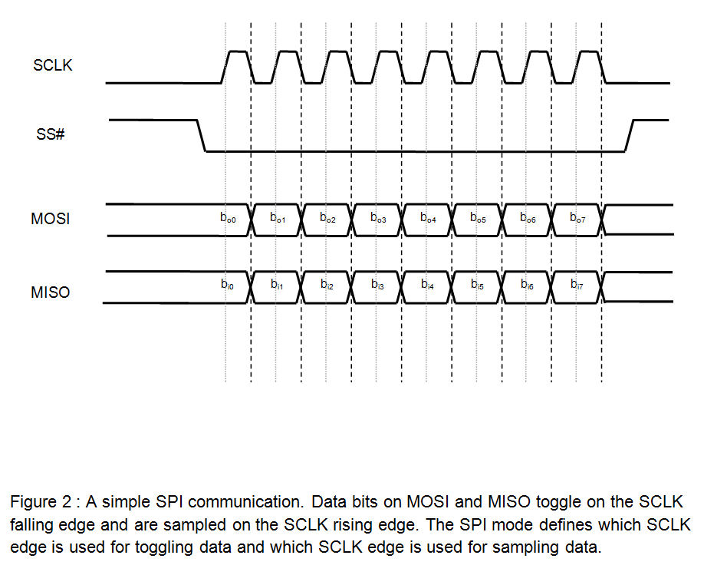
Based on Two important parameters, four modes of SPI are available.
1) Clock Polarity (CPOL)
2) Clock Phase (CPHA)

Slide 23
Mode | CPOL | CPHA
0 | 0 | 0
1 | 0 | 1
2 | 1 | 0
3 | 1 | 1
If clock polarity is 0 on first edge of SCLK clock pulse data is changed & at second edge data is transmitted.
If clock polarity is 1 on first edge of SCLK clock pulse data is transmitted & at second edge data is changed.
A master / slave pair must use the same set of parameters – SCLK frequency, CPOL & CPHA for a communication to be possible.

Slide 24
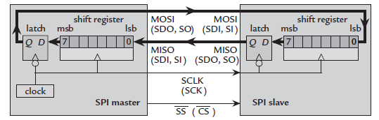

Slide 25
Implementing and Programming SPI Interface Using MSP430:
USCI Overview
The universal serial communication interface (USCI) modules support multiple serial communication modes. Different USCI modules support different modes. Each different USCI module is named with a different letter (for example, USCI_A is different from USCI_B).
If more than one identical USCI module is implemented on one device, those modules are named with incrementing numbers.
For example, if one device has two USCI_A modules, they are named USCI_A0 and USCI_A1.

Slide 26
The USCI_Ax modules support:
• UART mode
• Pulse shaping for IrDA communications
• Automatic baud rate detection for LIN
(Local Interconnect Network ) communications
• SPI mode
The USCI_Bx modules support:
• I2C mode
• SPI mode

Slide 27
USCI Introduction: SPI Mode
In synchronous mode, the USCI connects the MSP430 to an external system via three or four pins: UCxSIMO, UCxSOMI, UCxCLK, and UCxSTE (Slave Transmit Enable ). SPI mode is selected when the UCSYNC bit is set and SPI mode (3-pin or 4-pin) is selected with the UCMODEx bits.

Slide 28
SPI mode features include:
• 7- or 8-bit data length
• LSB-first or MSB-first data transmit and receive
• 3-pin and 4-pin SPI operation
• Master or slave modes
• Independent transmit and receive shift registers
• Separate transmit and receive buffer registers
• Continuous transmit and receive operation
• Selectable clock polarity and phase control
• Programmable clock frequency in master mode
• Independent interrupt capability for receive and transmit
• Slave operation in LPM4

Slide 29
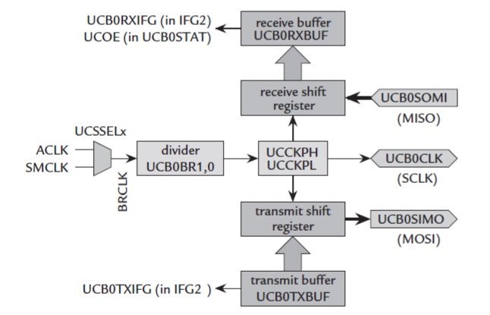

Slide 30
UCCKPH | Clock phase select
UCCKPL | Clock polarity select
UCMSB | MSB First Select : Controls the direction of receive and transmit register(if it is 0: LSB first)
UC7BIT | Selects the character length 7/8 bit(if it is 0 : 8 bit )
UCMST | Master mode select: 0=Slave mode, 1=Master mode
UCMODEx | USCI Mode: 2 bits used to select the synchronous mode when UCSYNC = 1
UCSYNC | Synchronous mode enable : if it is 1 synchronous mode(SPI)
Ex: UCA0CTL0 |= UCMST+UCSYNC+UCCKPL+UCMSB;

Slide 31
USCI Registers for SPI mode:
The registers and bits used for configuring the SPI are:
1) UCBxCTL0(USCI_Bx Control register0) :This register controls the settings for Parity selection, direction of data transmission(LSB or MSB first),character length, number of stop bits, modes of serial transmission.
2) UCBxCTL1--The two important bits contained in this register are
UCSSELx | These bits are used to select the clock source to the USCI module. Ex: 10 = SMCLK
UCSWRST | Software reset enable : 0 Disabled. USCI reset released for operation. 1 Enabled. USCI logic held in reset state.
Ex: UCB0CTL1 | = UCSSEL_2; // SMCLK
UCB0CTL1 & = ~UCSWRST; // **Initialize USCI (reset)state machine**

Slide 32
3) UCBxSTAT --The two important bits contained in Status register are
UCLISTEN | This bit is used to select the internal fed back mode.
UCBUSY | Indicates if a transmit or receive operation is in progress.
UCOE | Overrun error flag. This bit is set when a character is transferred into UCAxRXBUF before the previous character was read.

Slide 33
4) UCBxBR0and UCBxBR1--These are two 8 bit registers which are used to set the clock prescaler value of the Bit rate.
Ex: UCA0BR0 = 0x02; // /2 UCA0BR1 = 0;
5) UCBxTXBUF-- 8 bit data register for holding the byte to be transmitted by the MSP430 in SPI.
6) UCBxRXBUF--8 bit data register that stores the received byte.

Slide 34
USCI Operation: SPI Mode
In SPI mode, serial data is transmitted and received by multiple devices using a shared clock provided by the master. An additional pin, UCxSTE, is provided to enable a device to receive and transmit data and is controlled by the master.
Three or four signals are used for SPI data exchange:
• UCxSIMO: Slave in, master out
– Master mode: UCxSIMO is the data output line.
– Slave mode: UCxSIMO is the data input line.
• UCxSOMI: Slave out, master in
– Master mode: UCxSOMI is the data input line.
– Slave mode: UCxSOMI is the data output line.
• UCxCLK: USCI SPI clock
– Master mode: UCxCLK is an output.
– Slave mode: UCxCLK is an input.
• UCxSTE: Slave transmit enable
Used in 4-pin mode to allow multiple masters on a single bus.

Slide 35
USCI Initialization and Reset
The USCI is reset by a PUC (Power up clear ) or by the UCSWRST bit. After a PUC, the UCSWRST bit is automatically set, keeping the USCI in a reset condition. When set, the UCSWRST bit resets the UCxRXIE, UCxTXIE, UCxRXIFG, UCOE, and UCFE bits and sets the UCxTXIFG flag. Clearing UCSWRST releases the USCI for operation.
Character Format
The USCI module in SPI mode supports 7-bit and 8-bit character lengths selected by the UC7BIT bit. In 7- bit data mode, UCxRXBUF is LSB justified and the MSB is always reset. The UCMSB bit controls the direction of the transfer and selects LSB or MSB first.

Slide 36
Master Mode
The USCI as a master in both 3-pin and 4-pin configurations.
The USCI initiates data transfer when data is moved to the transmit data buffer UCxTXBUF.
The UCxTXBUF data is moved to the TX shift register when the TX shift register is empty, initiating data transfer on UCxSIMO starting with either the most-significant or least-significant bit depending on the UCMSB setting.
Data on UCxSOMI is shifted into the receive shift register on the opposite clock edge.
When the character is received, the receive data is moved from the RX shift register to the received data buffer UCxRXBUF and the receive interrupt flag, UCxRXIFG, is set, indicating the RX/TX operation is complete.
A set transmit interrupt flag, UCxTXIFG, indicates that data has moved from UCxTXBUF to the TX shift register and UCxTXBUF is ready for new data. It does not indicate RX/TX completion.

Slide 37
Slave Mode
The USCI as a slave in both 3-pin and 4-pin configurations.
UCxCLK is used as the input for the SPI clock and must be supplied by the external master.
The data-transfer rate is determined by this clock and not by the internal bit clock generator.
Data written to UCxTXBUF and moved to the TX shift register before the start of UCxCLK is transmitted on UCxSOMI.
Data on UCxSIMO is shifted into the receive shift register on the opposite edge of UCxCLK and moved to UCxRXBUF when the set number of bits are received.
When data is moved from the RX shift register to UCxRXBUF, the UCxRXIFG interrupt flag is set, indicating that data has been received.
The overrun error bit, UCOE, is set when the previously received data is not read from UCxRXBUF before new data is moved to UCxRXBUF.

Slide 38
SPI Enable
When the USCI module is enabled by clearing the UCSWRST bit it is ready to receive and transmit. In master mode the bit clock generator is ready, but is not clocked nor producing any clocks.
In slave mode the bit clock generator is disabled and the clock is provided by the master.
A transmit or receive operation is indicated by UCBUSY = 1.
A PUC or set UCSWRST bit disables the USCI immediately and any active transfer is terminated.
Transmit Enable
In master mode, writing to UCxTXBUF activates the bit clock generator and the data will begin to transmit. In slave mode, transmission begins when a master provides a clock and, in 4-pin mode, when the UCxSTE is in the slave-active state.
Receive Enable
The SPI receives data when a transmission is active. Receive and transmit operations operate concurrently.

Slide 39
Serial Clock Control
UCxCLK is provided by the master on the SPI bus. When UCMST = 1, the bit clock is provided by the USCI bit clock generator on the UCxCLK pin.
The clock used to generate the bit clock is selected with the UCSSELx bits. When UCMST = 0, the USCI clock is provided on the UCxCLK pin by the master, the bit clock generator is not used, and the UCSSELx bits are don’t care.
The SPI receiver and transmitter operate in parallel and use the same clock source for data transfer.
The 16-bit value of UCBRx in the bit rate control registers UCxxBR1 and UCxxBR0 is the division factor of the USCI clock source, BRCLK. The maximum bit clock that can be generated in master mode is BRCLK.
The UCAxCLK/UCBxCLK frequency is given by:
F_{BitClock}=f_{BRCLK} / UCBRx

Slide 40
Using the SPI Mode With Low-Power Modes
The USCI module provides automatic clock activation for SMCLK for use with low-power modes.
When SMCLK is the USCI clock source, and is inactive because the device is in a low-power mode, the USCI module automatically activates it when needed, regardless of the control-bit settings for the clock source.
The clock remains active until the USCI module returns to its idle condition. After the USCI module returns to the idle condition, control of the clock source reverts to the settings of its control bits. Automatic clock activation is not provided for ACLK.
It is possible to operate the USCI in SPI slave mode while the device is in LPM4 and all clock sources are disabled. The receive or transmit interrupt can wake up the CPU from any low power mode.

Slide 41
Low power Modes
Mode | CPU and CLOCKS
ACTIVE | CPU active. All enabled clocks active
LPM0 | CPU. MCLK disabled. SMCLK. ACLK active
LPM1 | CPU. MCLK disabled. DCO disabled if not used for SMCLK. ACLK active
LPM2 | CPU. MCLK. SMCLK. DCO disabled. ACLK active
LPM3 | CPU. MCLK. SMCLK. DCO disabled. ACLK active
LPM4 | CPU and all clocks disabled

Slide 42
SPI Interrupts
The USCI has one interrupt vector for transmission and one interrupt vector for reception.
SPI Transmit Interrupt Operation
The UCxTXIFG interrupt flag is set by the transmitter to indicate that UCxTXBUF is ready to accept another character.
An interrupt request is generated if UCxTXIE and GIE are also set. UCxTXIFG is automatically reset if a character is written to UCxTXBUF. UCxTXIFG is set after a PUC (Power Up Clear ) or when UCSWRST = 1.
UCxTXIE is reset after a PUC or when UCSWRST = 1.
SPI Receive Interrupt Operation
The UCxRXIFG interrupt flag is set each time a character is received and loaded into UCxRXBUF. An interrupt request is generated if UCxRXIE and GIE are also set. UCxRXIFG and UCxRXIE are reset by a system reset PUC signal or when UCSWRST = 1. UCxRXIFG is automatically reset when UCxRXBUF is read.

Slide 43
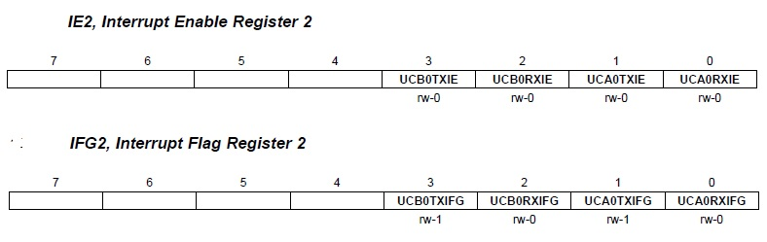
USCI Interrupt Usage
USCI_Ax and USCI_Bx share the same interrupt vectors. The receive interrupt flags UCAxRXIFG and UCBxRXIFG are routed to one interrupt vector, the transmit interrupt flags UCAxTXIFG and UCBxTXIFG share another interrupt vector.
Interrupts of MSP430 SPI mode are:

Slide 44
IE2: Interrupt Enable Register 2
UCB0TXIE | Used to enable/disable the transmit interrupt.
UCB0RXIE | Used to enable/disable the receive interrupt.
Ex: UC0IE |= UCB0RXIE; // Enable USCI_B0 RX interrupt
UC0IE |= UCB0TXIE; // Enable USCI_B0 TX interrupt
IFG2: Interrupt Flag Register 2
UCB0TXIFG | USCI_A0 transmit interrupt flag is set when UCA0TXBUF is empty
UCB0RXIFG | USCI_A0 receive interrupt flag is set when UCA0RXBUF have received a complete character.

Slide 45
I²C : Inter Integrated Circuit
I²C is a synchronous interface. It is a standard bidirectional interface that uses a controller, known as the master to communicate with slave devices.
A slave may not transmit data unless it has been addressed by the master.
The physical I²C interface consists of the serial clock (SCL) and serial Data (SDA) lines. Both SDA and SCL lines must be connected to v_{cc} through a pull up resistor. The size of pull up resistor is determined by the amount of capacitance on the I²C lines. Data transfer may be initiated only when the bus is idle.
A bus is idle if both SCL and SDA lines are high after a STOP condition.

Slide 46
The general procedure for a master to access a slave device is the following:
Suppose a master wants to send data to slave :
    Master – transmitter sends a START condition and address the slave – receiver.
    Master – transmitter sends data to slave – receiver.
    Master – transmitter terminates the transfer with a STOP condition.
If a master wants to receive / read data from a slave:
Master – receiver sends a START condition and Addresses the slave – transmitter.
Master – receiver sends the requested register to read to slave – transmitter.
Master – receiver receives data from the slave – transmitter.
Master – receiver terminates the transfer with a STOP condition.

Slide 47
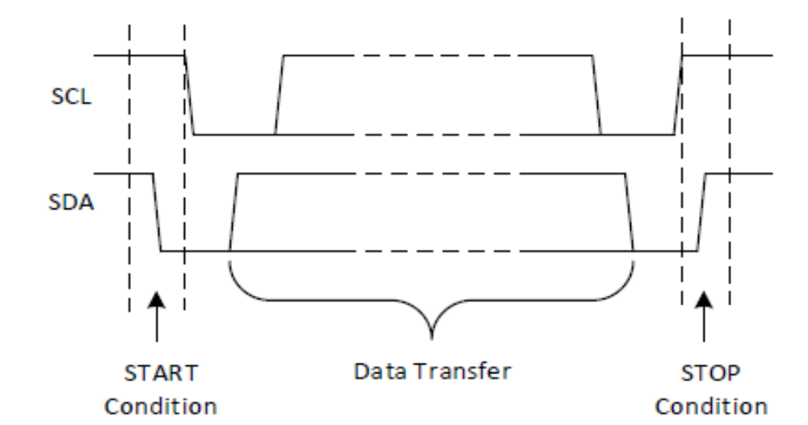
START and STOP Conditions:
I²C communication with the device is initiated by master sending a START condition and terminated by master sending a stop condition. A high – to – low transition on the SDA line which the SCL is high defines a STOP condition.

Slide 48
I²c Protocol:
I²c is a multi – master – protocol that uses 2 signal lines. The two I²c signals are called ‘serial data’ (SDA) and ‘serial clock’ (SCL).
Virtually any number of slaves and any number of masters can be connected onto these 2 signal lines and communication between each other using a protocol that defines :
7 bits slave addresses: each device connected to the bus has got a unique address.
Data divided into 8 – bit a byte.
A few control bits for controlling the communication start, end, direction and for an acknowledgment mechanism.

Slide 49
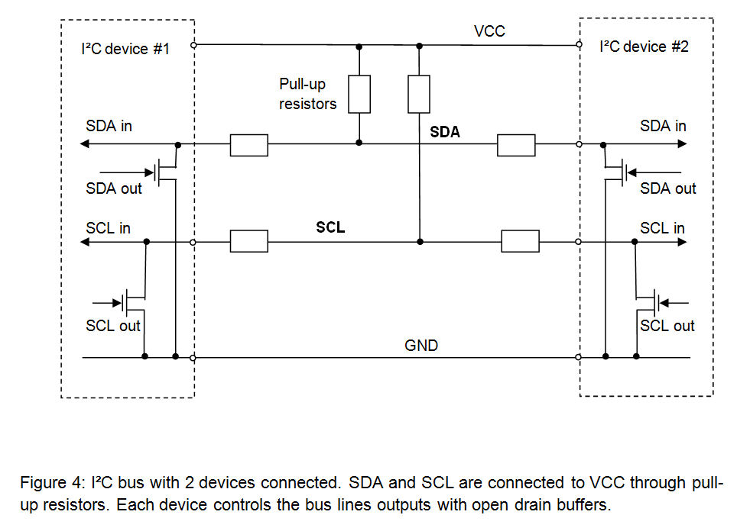
The data rate has to be chosen between 100 kbps, 400 kbps and 3.4 kbps respectively called standard mode, fast mode and high speed mode.

Slide 50
Physically, the I²c bus consists of 2 active wires SDA and SCL and a ground connection as shown in above fig. the active wires are both bi-directional.
First the master will issue a START condition.
Then the master sends the ADDRESS of the device it wants to access, along with an indication whether the access is a Read or Write operation.

Slide 51
Having received the address, all IC’s will compare with their own address. If it doesn’t match, they simply wait until the bus is released by stop condition. If address matches, it will produce a response called Acknowledge signal.
Once the master receives the acknowledgement, it can start transmitting or receiving data. When all data is sent, the master will issue the STOP condition.
When a master wants to receive data from a slave, it proceeds the same way, but sets RD/WR bit at a logical one. Once the slave has acknowledged the address, it starts sending the requested data, byte by byte.

Slide 52
Implementing and Programming I²C Interface Using MSP430:
The universal serial communication Interface (USCI) modules support multiple serial communication modes.
USCI_Bx modules support
I²C Mode
SPI Mode
USCI Introduction: I2C Mode
In I2C mode, the USCI module provides an interface between the MSP430 and I2C-compatible devices connected by way of the two-wire I2C serial bus. External components attached to the I2C bus serially transmit and/or receive serial data to/from the USCI module through the 2-wire I2C interface.

Slide 53
The I2C mode features include:
– 7-bit and 10-bit device addressing modes
– General call
– START/RESTART/STOP
– Multi-master transmitter/receiver mode
– Slave receiver/transmitter mode
– Standard mode up to 100 kbps and fast mode up to 400 kbps support
• Programmable UCxCLK frequency in master mode
• Designed for low power
• Slave receiver START detection for auto-wake up from LPMx modes
• Slave operation in LPM4

Slide 54
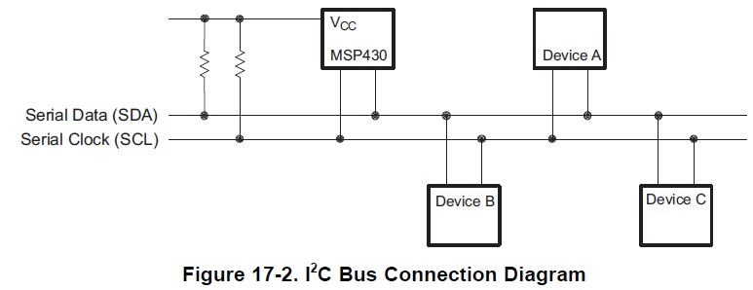
USCI Operation: I2C Mode
The I2C mode supports any slave or master I2C-compatible device.
Each I2C device is recognized by a unique address and can operate as either a transmitter or a receiver.
A device connected to the I2C bus can be considered as the master or the slave when performing data transfers.
A master initiates a data transfer and generates the clock signal SCL. Any device addressed by a master is considered a slave.
I2C data is communicated using the serial data pin (SDA) and the serial clock pin (SCL).
Both SDA and SCL are bidirectional, and must be connected to a positive supply voltage using a pullup resistor.

Slide 55
USCI Initialization and Reset
The USCI is reset by a PUC or by setting the UCSWRST bit. After a PUC, the UCSWRST bit is automatically set, keeping the USCI in a reset condition.
To select I2C operation the UCMODEx bits must be set to 11.
After module initialization, it is ready for transmit or receive operation.
Clearing UCSWRST releases the USCI for operation.
I2C Serial Data
One clock pulse is generated by the master device for each data bit transferred.
The I2C mode operates with byte data. Data is transferred most significant bit first.
I2C Addressing Modes
I²C mode supports 7-bit and 10-bit addressing modes.

Slide 56

7-Bit Addressing:
In the 7-bit addressing format, the first byte is the 7-bit slave address and R/W bit. The ACK bit is sent from the receiver after each byte of reception.

Slide 57

10-Bit Addressing:
In the 10-bit addressing mode, the first byte is made up of 11110b plus the two MSB’s of the 10-bit slave address and R/W bit.
The ACK bit is sent from the receiver after each byte of reception.
The next byte is the remaining eight bits of the 10-bit slave address followed by ACK bit and 8-bit data.

Slide 58

USCI_B I²C Mode Register:
The registers and bits used for configuring the I2C are:
1) UCBxCTL0(USCI_Bx Control register0) :
UCA10 | Own addressing mode select 0 Own address is a 7-bit address 1 Own address is a 10-bit address
UCSLA10 | Slave addressing mode select 0 Address slave with 7-bit address 1 Address slave with 10-bit address
UCMM | Multi-master environment select
UCMST | Master mode select: 0=Slave mode, 1=Master mode
UCMODEx | USCI Mode: 2 bits used to select the synchronous mode when UCSYNC = 1 11 I2C mode
UCSYNC | Synchronous mode enable : if it is 1 synchronous mode(SPI)

Slide 59
2) UCBxCTL1--The important bits contained in this register are
UCSSELx | These bits are used to select the clock source to the USCI module. Ex: 10 = SMCLK
UCSWRST | Software reset enable : 0 Disabled. USCI reset released for operation. 1 Enabled. USCI logic held in reset state.
UCTR | Transmitter/receiver
UCTXSTP | Transmit STOP condition in master mode.
UCTXSTT | Transmit START condition in master mode.

Slide 60
3) UCBxBR0and UCBxBR1--These are two 8 bit registers which are used to set the clock pre scaler value of the Bit rate.
4) UCBxSTAT --The important bits contained in Status register are
UCSCLLOW | SCL low
UCBUSY | Indicates if a transmit or receive operation is in progress.
UCNACKIFG | Not-acknowledge received interrupt flag.
5) UCBxTXBUF-- 8 bit data register for holding the byte to be transmitted by the MSP430 in SPI.
6) UCBxRXBUF--8 bit data register that stores the received byte.
7) UCBxI2COA Register: USCIBxI2C own Address Register: Stores master address & it is right justified.
8) USCIBxI2CSA Register: USCIBxI2C Slave Address Register: Stores slave address & it is right justified

Slide 61
9) UCBxIE Register: USCI_BX I2C Interrupt Enable Register
UCNACKIE | Not-acknowledge interrupt enable
UCSTPIE | Stop condition interrupt enable
UCSTTIE | Start condition interrupt enable
IE2: Interrupt Enable Register 2
UCB0TXIE | Used to enable/disable the transmit interrupt.
UCB0RXIE | Used to enable/disable the receive interrupt.
Ex: UC0IE |= UCB0RXIE; // Enable USCI_B0 RX interrupt
UC0IE |= UCB0TXIE; // Enable USCI_B0 TX interrupt

Slide 62
IFG2: Interrupt Flag Register 2
UCB0TXIFG | USCI_A0 transmit interrupt flag is set when UCA0TXBUF is empty
UCB0RXIFG | USCI_A0 receive interrupt flag is set when UCA0RXBUF have received a complete character.
Interfacing External Devices:
Many members of the MSP430 family have integrated A/D converters (ADCs), but in some applications the required analog conversion function is remote, optional, or perhaps an afterthought. In these types of applications, using external ADCs such as the low-cost, easy to use TLC549 and TLV1549 are options.The TLC549 interfaces serially with the MSP430F1121 using three I/O pins with no external components.

Slide 63
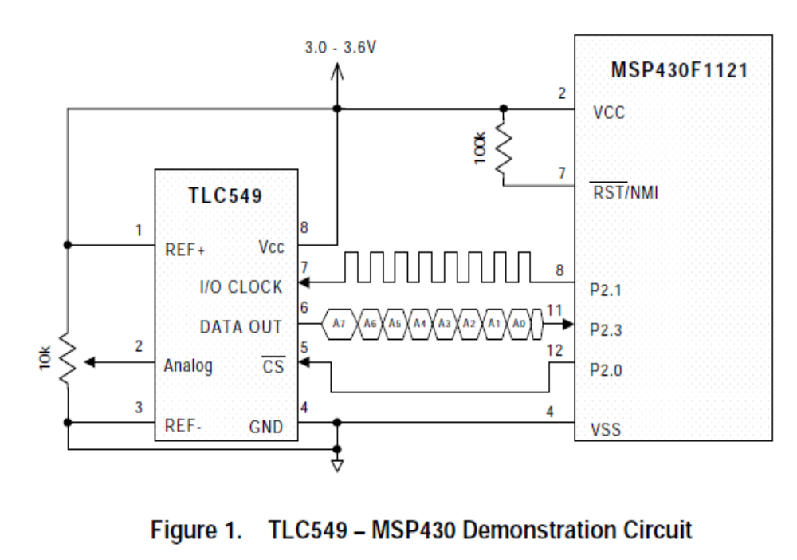

Slide 64
Operation:
Using three digital I/O pins, the MSP430F1121 drives the TLC549 A/D conversion using asynchronous serial interface.
In this application report, MSP430 I/O pins P2.0 and P2.1 are configured as outputs using the P2 direction register (P2DIR) and set/reset using the P2 output register (P2OUT).
Pin P2.0 interfaces with the TLC549 chip select (CS) pin P2.1 with theTLC549 input-output clock (I/O CLK).
When CS is high, DO is in a high-impedance state and I/O CLK inactive.
To begin the conversion, the MSP430 brings CS low.
To drive a complete conversion, the MSP430generates a total of eight clock pulses on P2.1 which are applied to the TLC549 I/O CLK.

Slide 65
AfterCS has been brought low, the most significant bit (MSB) from the previous conversion appears on D0.
The MSP430 reads the conversion data on D0 on pin P2.3 and serially shifts the data into a register ADCDATA (R11).
The falling edge of the fourth clock begins the sample function of the analog signal present at the analog terminal of theTLC549.
Three more clock pulses are applied to I/O CLK shifting out the least three most significant bits from the previous conversion.
The falling edge of the final (eighth) clock pulse terminates the TLC549 sample function and the hold and conversion cycle begins.

Slide 66
THANK
YOU

